Slide 1
System Mapping 101
Dr. Alina Turner
David French
Jennifer Tipple
Marty Thompsen
October 23rd, 2018

Slide 2
Systems
Mapping 101
Dr. Alina Turner, Turner Strategies
October 23, 2018

Slide 3
What is it?
Essential first step in any effort to apply a systems planning approach to complex social issues, like homelessness.
It involves methodically finding, categorizing, and analyzing social assets/resources operating in your community.

Slide 4
What does it involve?
Must-have now vs. must-have later.
Up-to-date resource directory for all services available for those at risk/homeless in community.
Categorization of all programs by target population, geographical scope, service focus.
Mapping of locations to discern location patterns.
Real-time occupancy report to show what spaces are available in services.
Clear eligibility criteria, access/referral process for those looking for help.
Feedback loop from clients/users of services to each of the resources.
Performance indicators to track community demand and feedback on services.

Slide 5
What do you need to capture?
Starting with the homeless-serving system, then beyond.
Basic Info: Name, Address, Contact Info
Program/Housing Type
Capacity (Units/ Beds/ Caseload)
% Occupancy/ Fill Rate (Currently or Average)
Length of Stay (Average)
Target populations (DV/ families/ youth/ Indigenous/refugees, etc.)
Eligibility & Prioritization Criteria
Participation in Coordinated Intake (y/n)
Acuity Assessment Tool Use
Target Level of Client Acuity (Low/ Med/ High)
% Capacity Accessible to Chronic/ Episodic
% Capacity-Low Barrier (active substance use)
% Capacity-High Barrier (sobriety required)
% Return to Homeless-ness w/in 1yr
% Exits to Permanent Housing
Estimated Annual Funding per program

Slide 6
Program/ Housing Type | Capacity (Units/ Beds/ Caseload) | % Occupancy/ Fill Rate (Currently or Average) | # Vacant Permanent Housing Units Currently | Length of Stay (Average) | Target populations (DV/families/ Youth/ Aboriginal) | Eligibility Criteria | Prioritization Criteria | Participation in Coordinated Intake (y/n) | Acuity Assessment Tool Use | Target Level of Client Acuity (Low/ Med/ High) | % Capacity Accessible to Chronic/ Episodic | % Capacity-Low Barrier (active substance use) | % Capacity-High Barrier (sobriety required) | % Return to Homeless-ness w/in 1yr | % Exits to Permanent Housing | Estimated Annual Funding
Emergency Shelter
Transitional Housing
Affordable Housing
Permanent Supportive Housing
Rent Supplements
Outreach
Rapid Rehousing
Intensive Case Management
Assertive Community Outreach
Other Support Services (List)

Slide 7

7
Why does this matter?
Health
Poverty Reduction
Justice
The homeless-serving system is only a part of the social safety net ecosystem.
Homeless-Serving System
Housing
Children’s Services
Education
Social Services

Slide 8
8
for instance
In Calgary, Housing First programs make up <0.5% of the services available to those at risk/experiencing homelessness and their $1 billion annual budget.
WITHOUT private or informal services.

Slide 9
9
Making Coordinated access work
Your real-time System Map tells you what you have available.
It also allows you to leverage what your entire community has, not just what you fund/operate.
The By-Names-List (BNL) tells you what you need.
You need to match people to resources based on needs.

Slide 10




STEP-BY-STEP
1. Find all the resource lists in your community, cross-reference, categorize. Don’t forget your public systems (health), informal services (churches) and private sector (counsellors).
2. Engage the players to update their info, list their programs & services in a common database. Ideally, you’d make sure this is available publicly so your system becomes transparent to people in need.
3. Work to develop a real-time occupancy report and integrate this into your Coordinated Access process.
4. Introduce client feedback mechanisms across the ecosystem; use the data to gauge impact, trends, and strategy development/adjustment in real-time.
Get excited about Big Data!

Slide 11

Lethbridge Asset Mapping Project (LAMP)
Marty Thomsen, Community Social Development, City of Lethbridge
October 23, 2018

Slide 12

We all hold an oar to
the dragon boat.

Slide 13
Lethbridge context
Growing community with new/changing pressure points
Coordination of assets remains a challenge
Strategic response needed to tie diverse sectors into coordinated approach
Better leveraging & coordination of resources for those in need

Slide 14
OUR APPROACH
Analysis of a newly developed asset map and related database (HelpSeeker)
2. Social network analysis of organizations providing social supports and services in Lethbridge (Network Survey)
3. Extensive, cross-sectoral engagement & consultation (business, public, non-profit, government, lived exp.)
4. Research & best practice analysis (local/national/international - academic/grey)

Slide 15
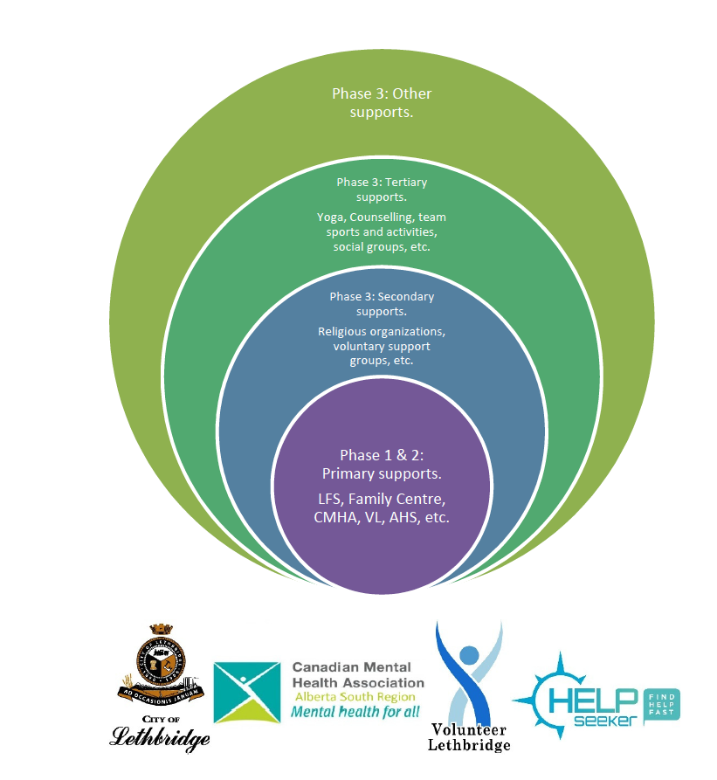
MAPPING OUR SYSTEM
Estimate 1,000 services in
community of 100,000
We have 250 mapped out w/
data coming in
Significant engagement to date

Slide 16
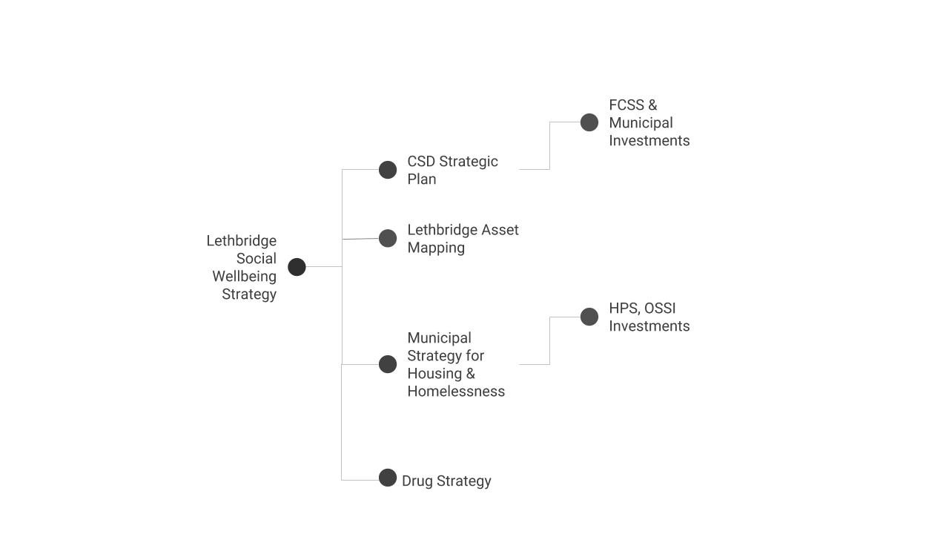
AT A GLANCE

Slide 17
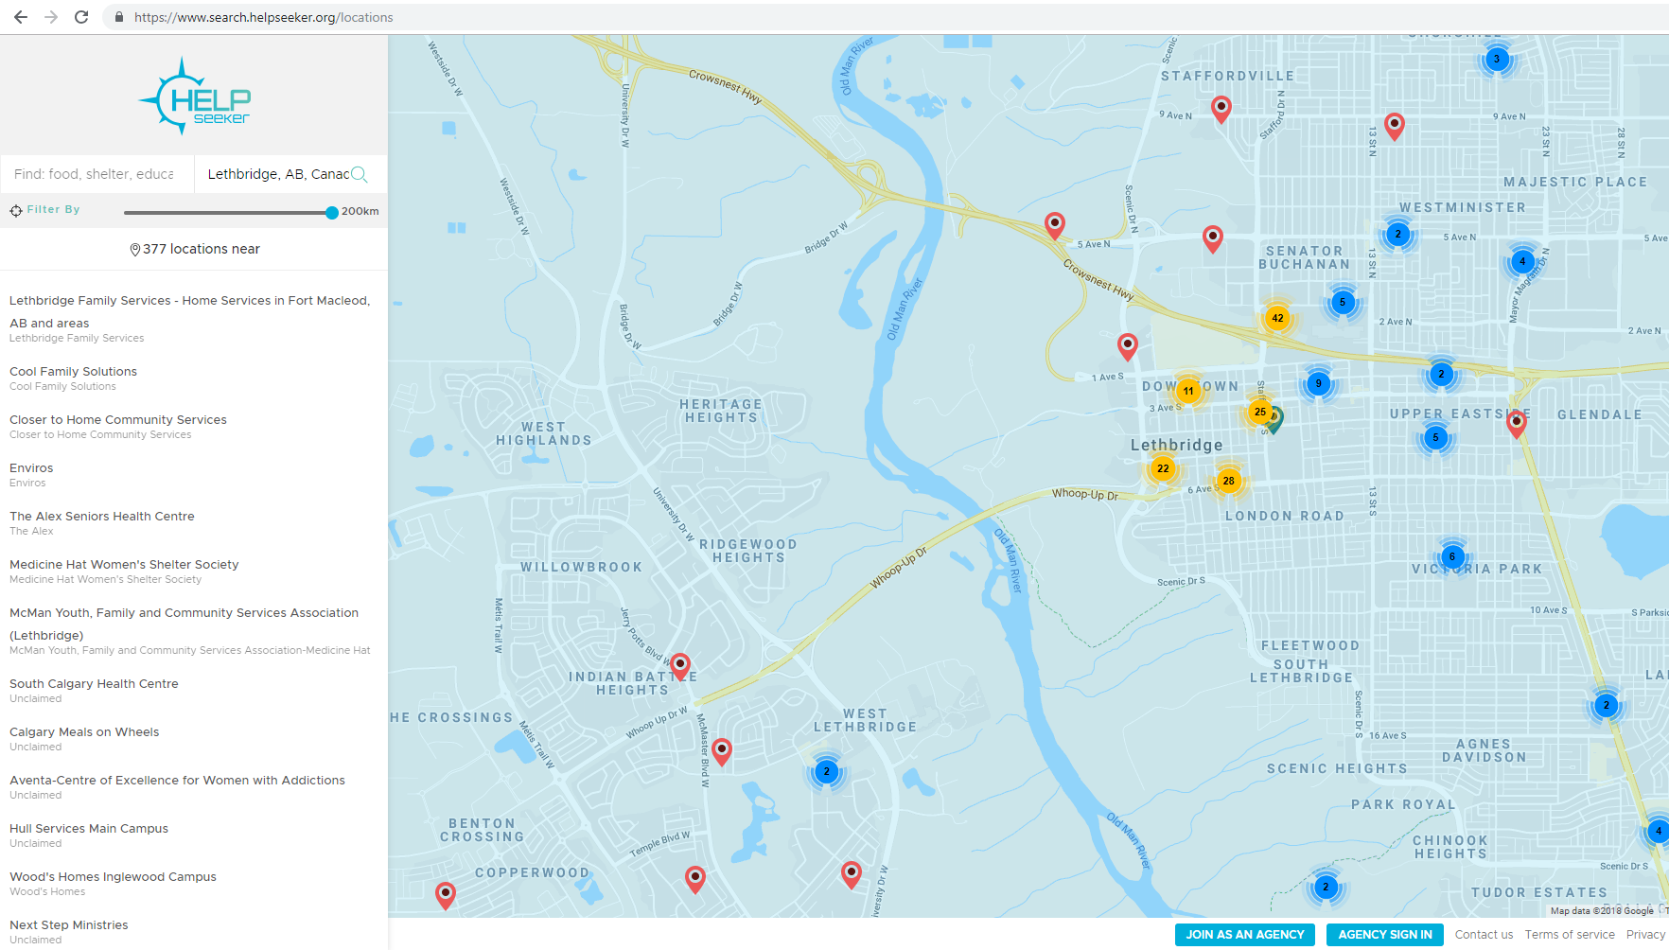
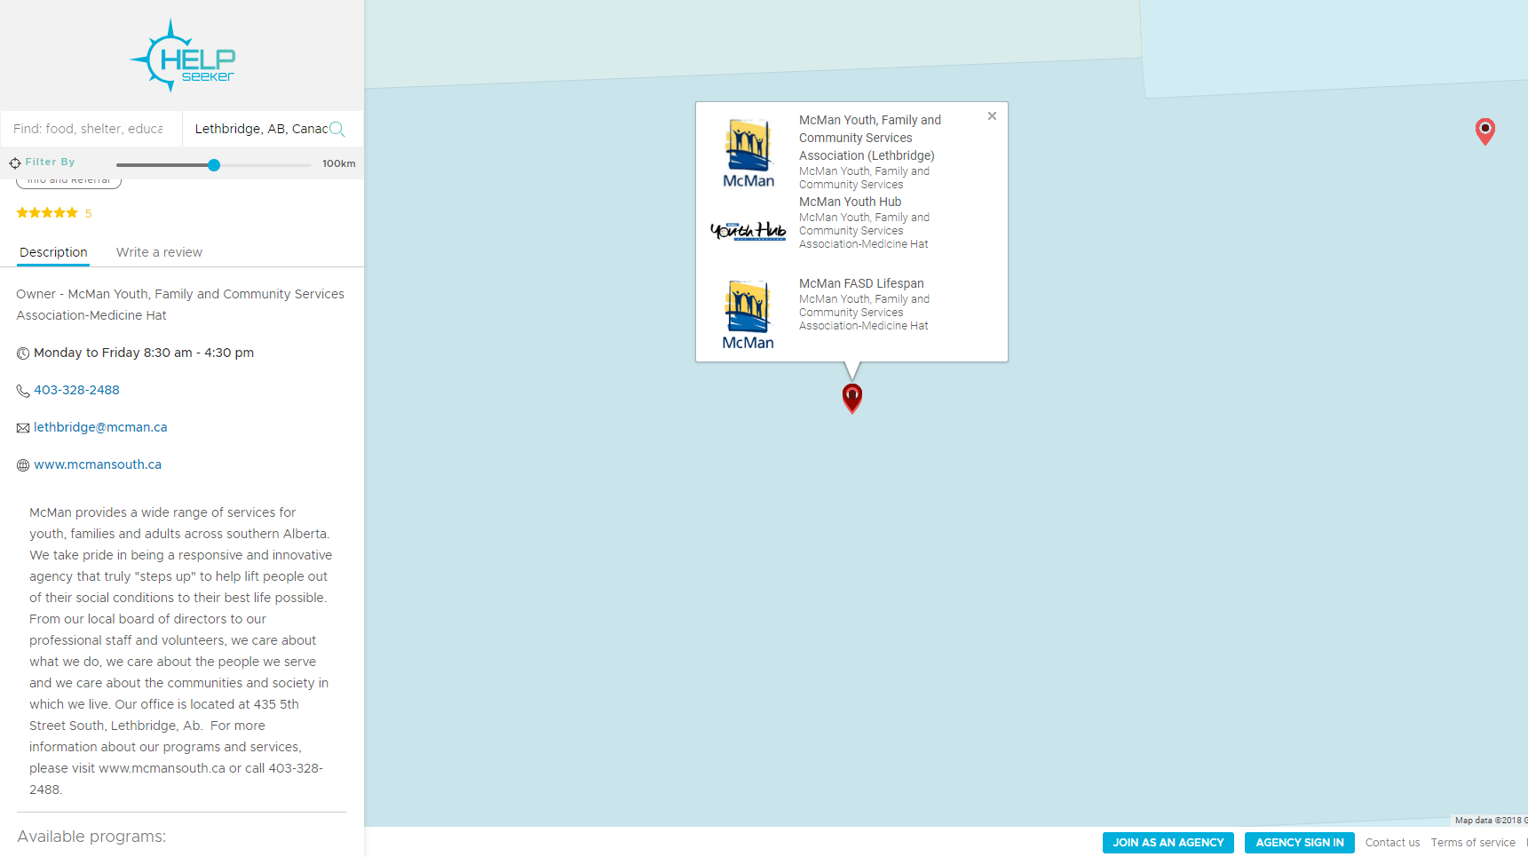
A LIVE PUBLICALLY AVAILABLE MAP OF COMMUNITY RESOURCES

Slide 18
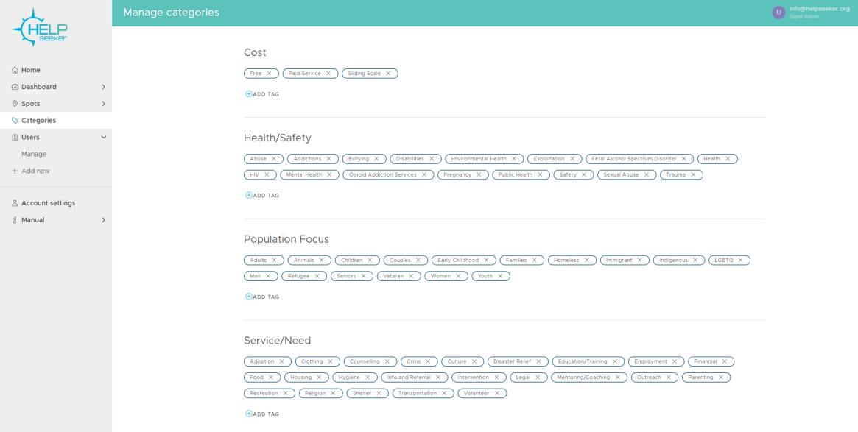
MAKING SENSE OF HUNDREDS OF SERVICES

Slide 19
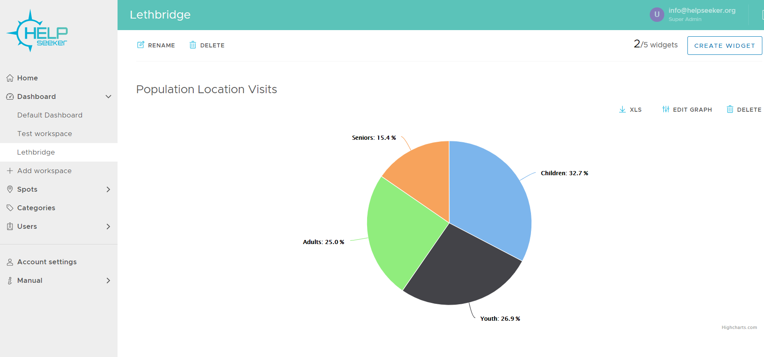
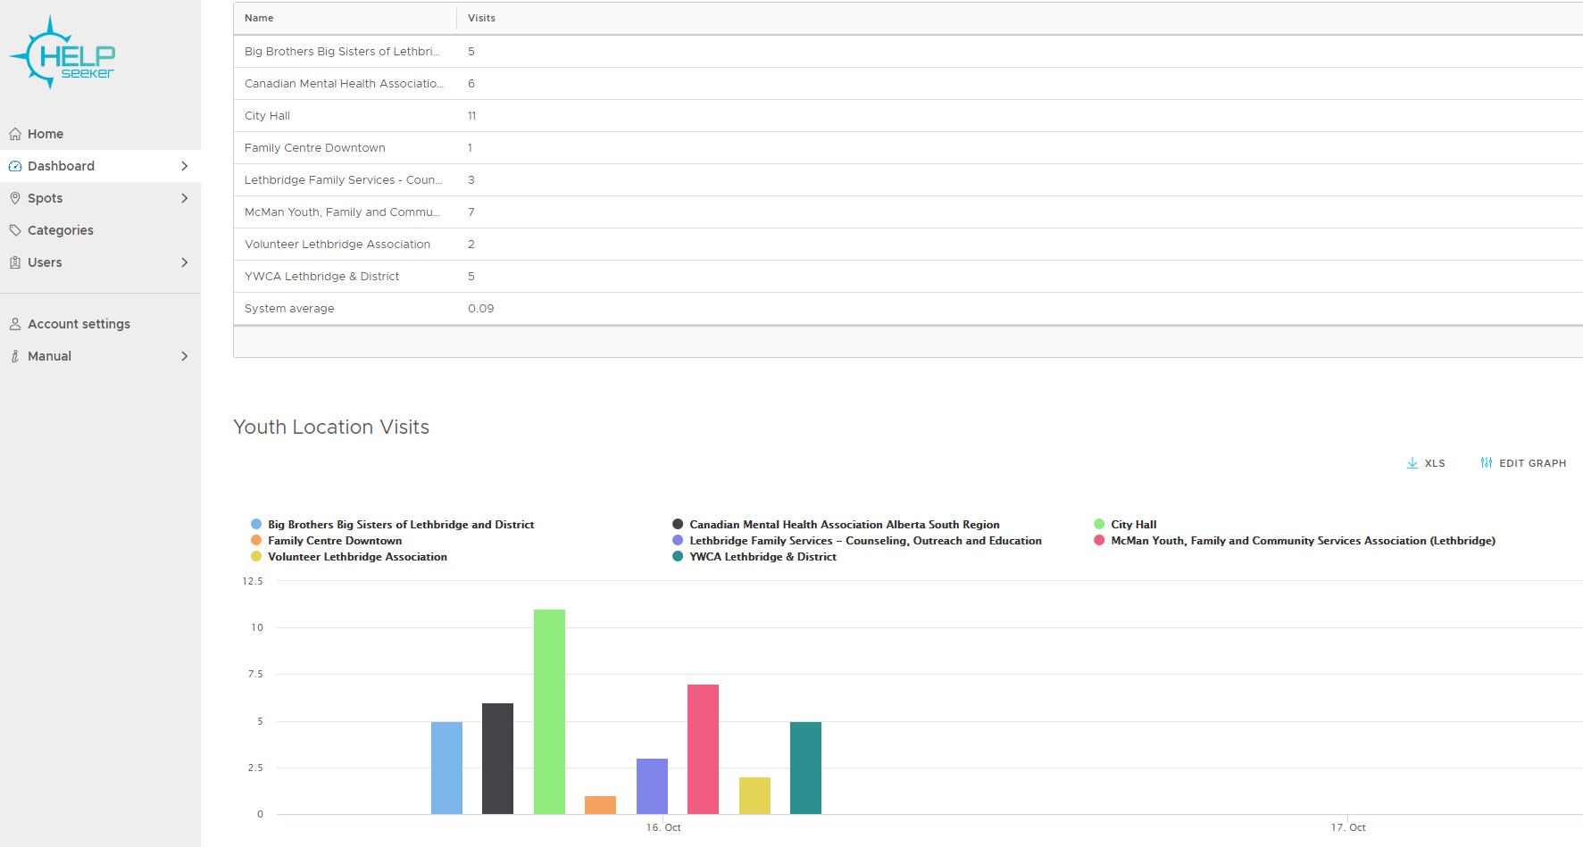
REAL-TIME ANALYTICS TO TRACK SERVICE DEMAND BY POPULATION, SERVICE FOCUS

Slide 20
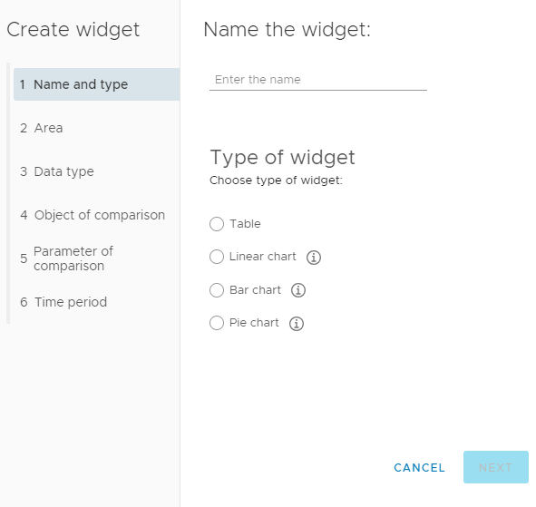
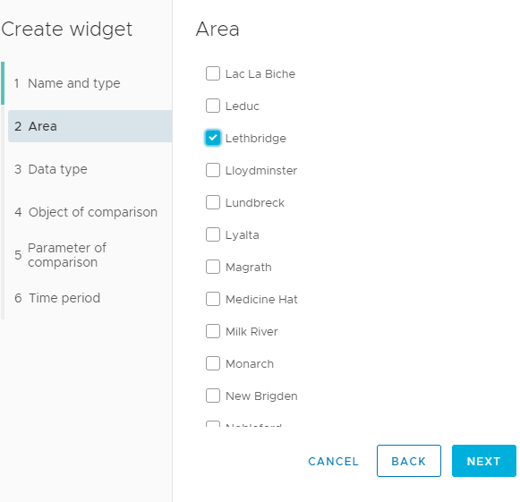
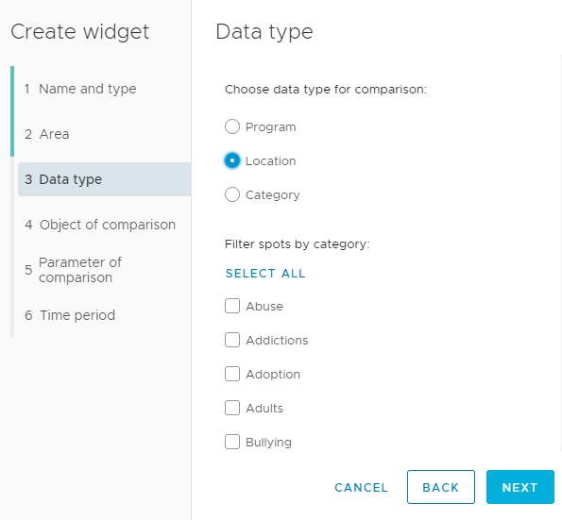
COMPARING TRENDS ACROSS REGIONS, PROGRAMS, SERVICE CATEGORIES & CLIENT FEEDBACK

Slide 21
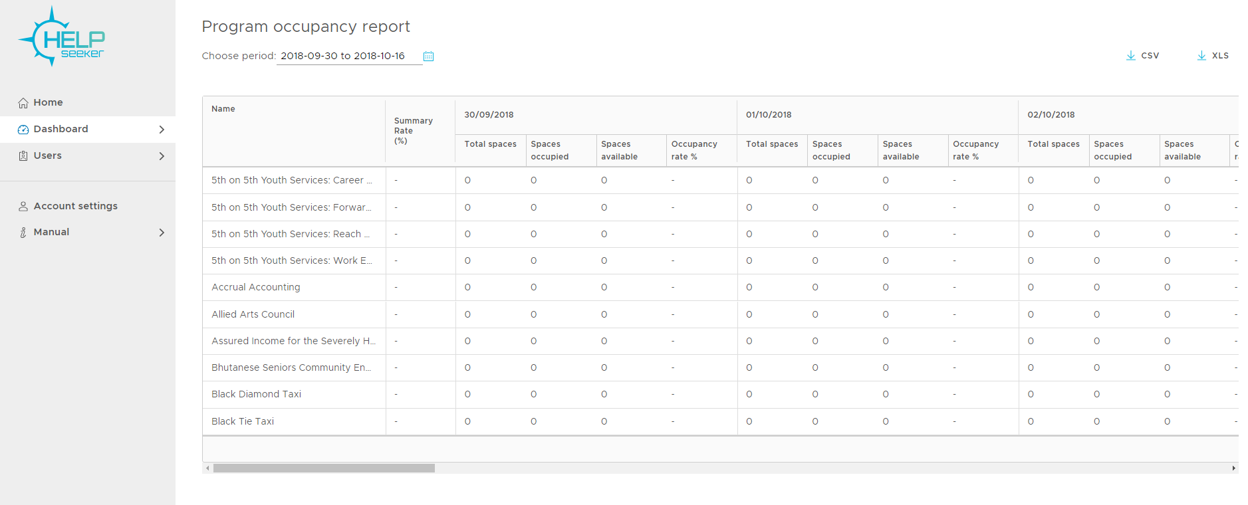
TAKING IT TO THE NEXT LEVEL:
REAL-TIME SYSTEM OCCUPANCY

Slide 22
Systems Mapping in St. John’s, NL
Jennifer Tipple, Performance Management Planner
End Homelessness St. John’s
October 23, 2018

Slide 23
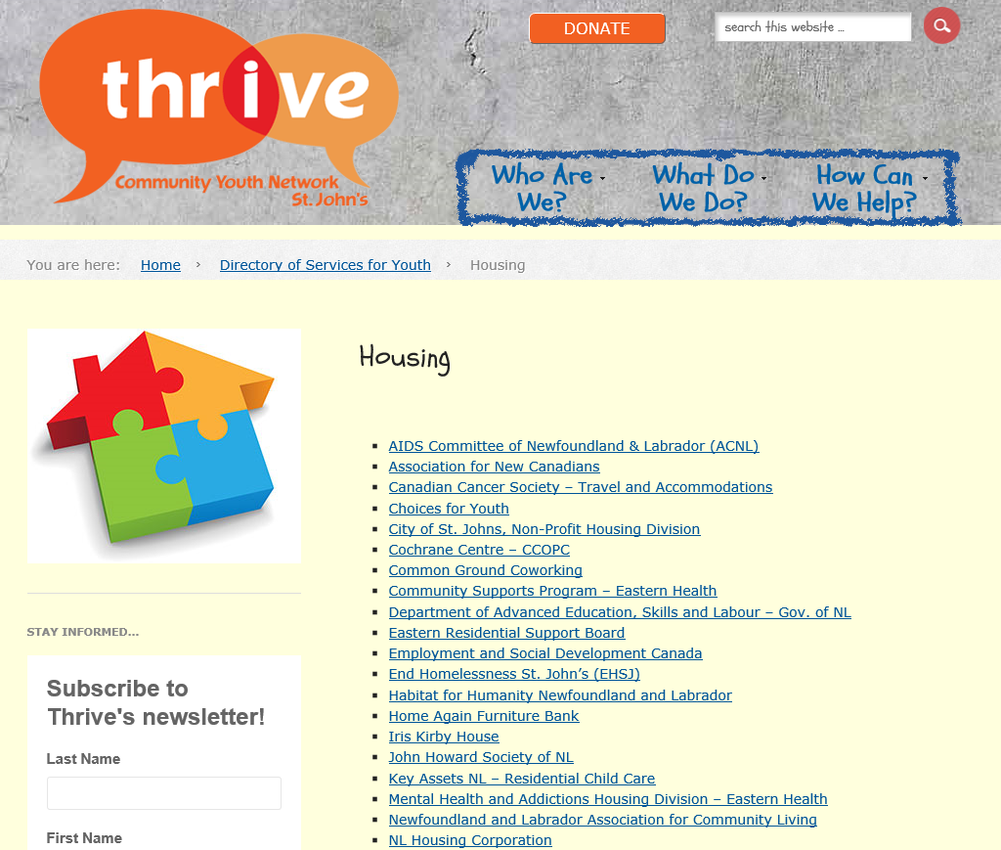
current systems map
Hosted by Thrive CYN
Static website listing + 251-page PDF
Updated annually
6 categories
  Housing
  Recreation
  Employment
  Justice
  Learning
  Health

Slide 24
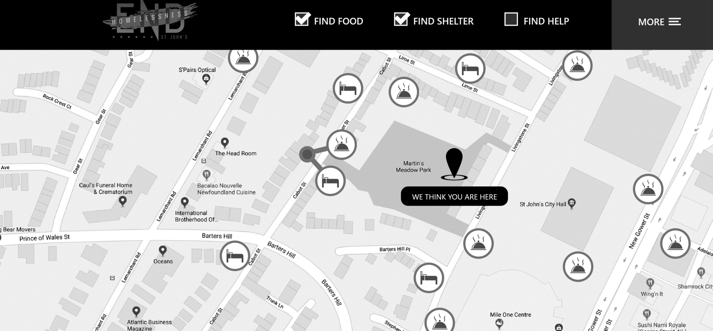
Upcoming systems map
Integrated into EHSJ website front page
Interactive map-based listing
Updated as required
3 major categories
46 filters, ranging from case management to showers
Integration with HelpSeeker

Slide 25



Systems map components
Must-have now vs. must-have later.
Phase I Phase II
Up-to-date resource directory
Categorization of all programs
Mapping of locations
Real-time occupancy report
Clear eligibility criteria
Feedback loop
Performance indicators

Slide 26
Getting to phase i
Must-have now vs. must-have later.
You will need:
Dedicated staff capacity
Attention to detail
Compatibility with other initiatives
  i.e. Coordinated Access
  Weekly Systems Capacity Report
Phase I
Up-to-date resource directory
Categorization of all programs
Mapping of locations
Real-time occupancy report
Clear eligibility criteria

Slide 27

Getting to phase II
Phase II
You will need:
Feedback from clients, staff, etc.
Info on program evolution
  HF fidelity
  Acuity mix, funding, etc.
Ongoing data collection
  % occupancy
  Delivery on outcomes
  (i.e. housing stability)
Up-to-date resource directory
Categorization of all programs
Mapping of locations
Real-time occupancy report
Clear eligibility criteria
Feedback loop
Performance indicators

Slide 28
Integrating with coordinated access
By Name List (BNL)
Systems Capacity Report
  Currently updated weekly
Collective Impact Working Group
  For cases requiring a collaborative response
Systems Coordination Table
  High-level systems table to identify and fill gaps in system responses
Overarching principles:
Collaboration
Transparency
Accountability
Efficiency of resources
Focus on participant needs

Slide 29
Thanks for listening!
For more info:
jtipple@stjohns.ca
709.685.4068

Slide 30
Systems
Mapping 101
David French, Director of Policy and Planning
A Way Home Canada
October 23, 2018

Slide 31
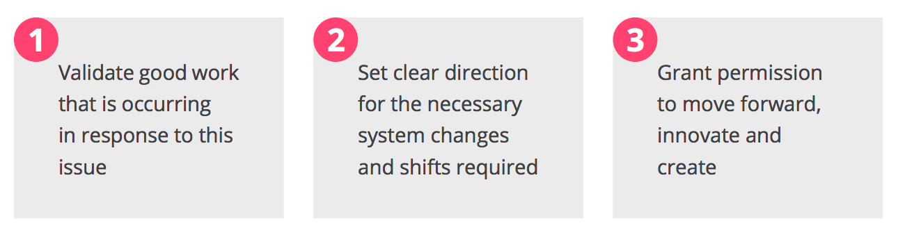
System Planning impacts:
  Think beyond “just” the homeless sector
  Community nimbleness can inform broader planning
  Capturing lived experience is foundational

Slide 32
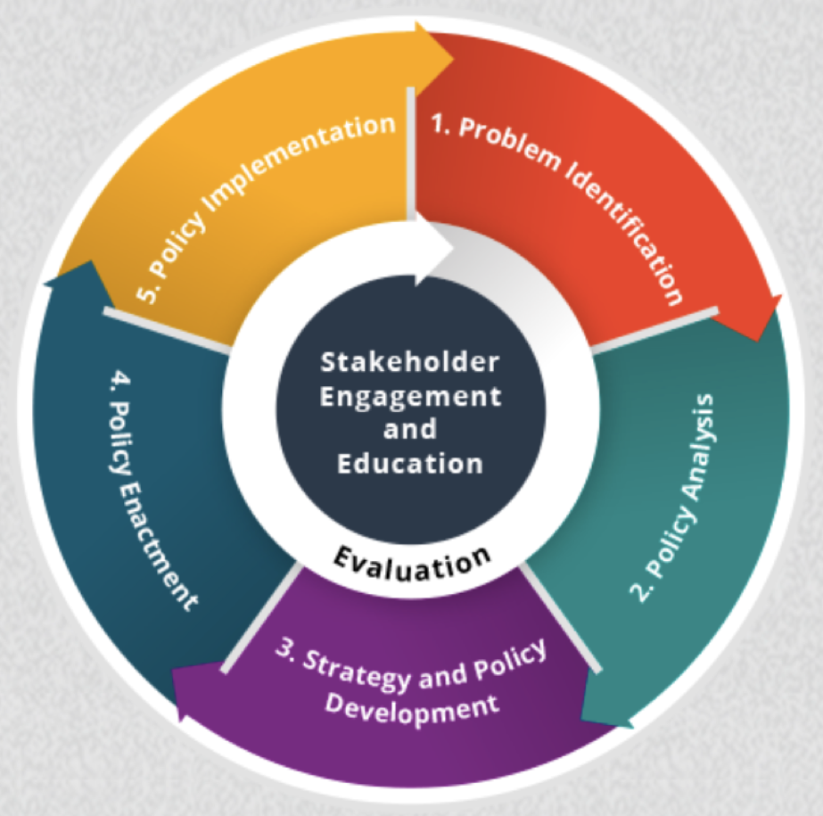
Inform broader planning:
Community lead solutions can become comprehensive policy responses.
Track your progress (palatably), so insights and learning can be shared.

Slide 33
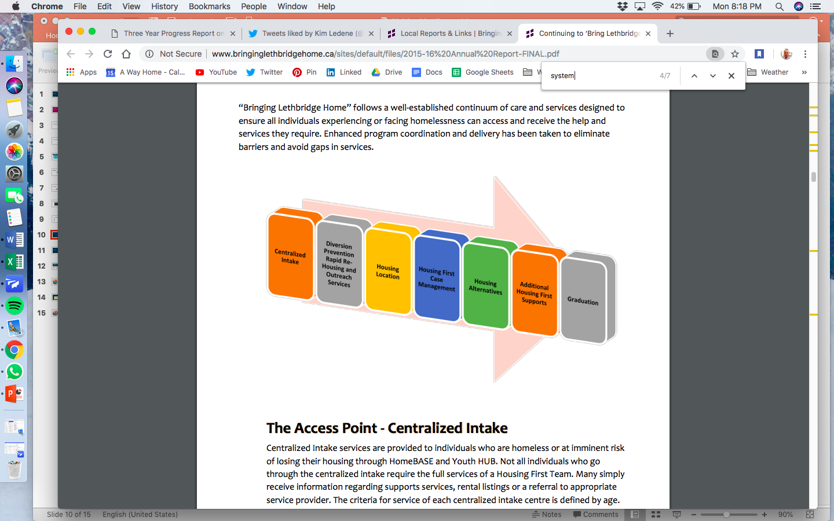
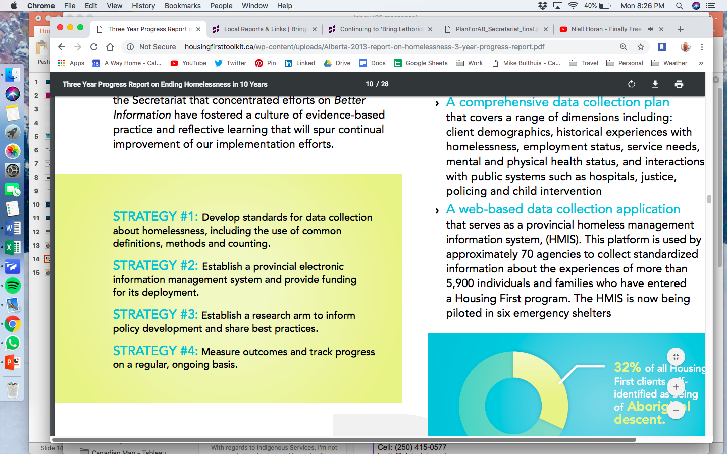
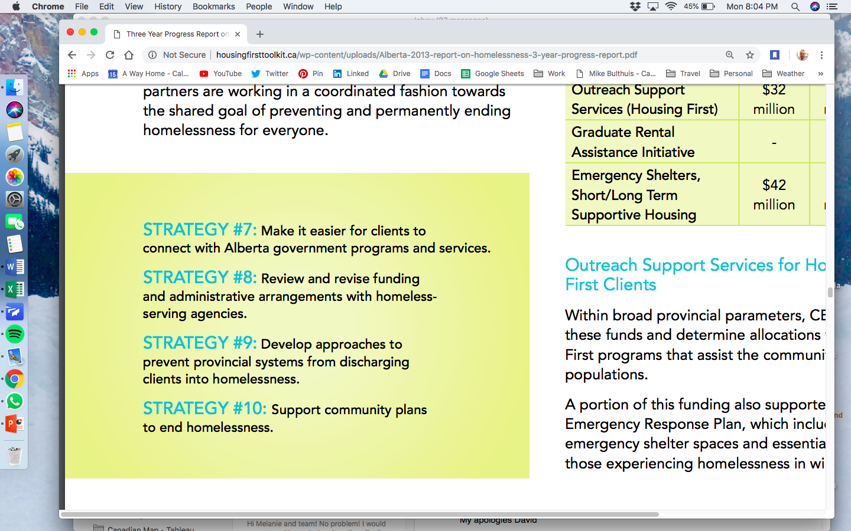
Bring Lethbridge Home
Centralized Access
A Plan for Alberta: Ending Homelessness in 10 Years

Slide 34
Want to streamline system planning?
Work to align demographic data (ie. youth age, ethnicity);
Facilitate opportunities to share that data across programs;
Delineate between risk of homelessness / risk of prolonged homelessness; and
Adopt a collective impact approach.

Slide 35
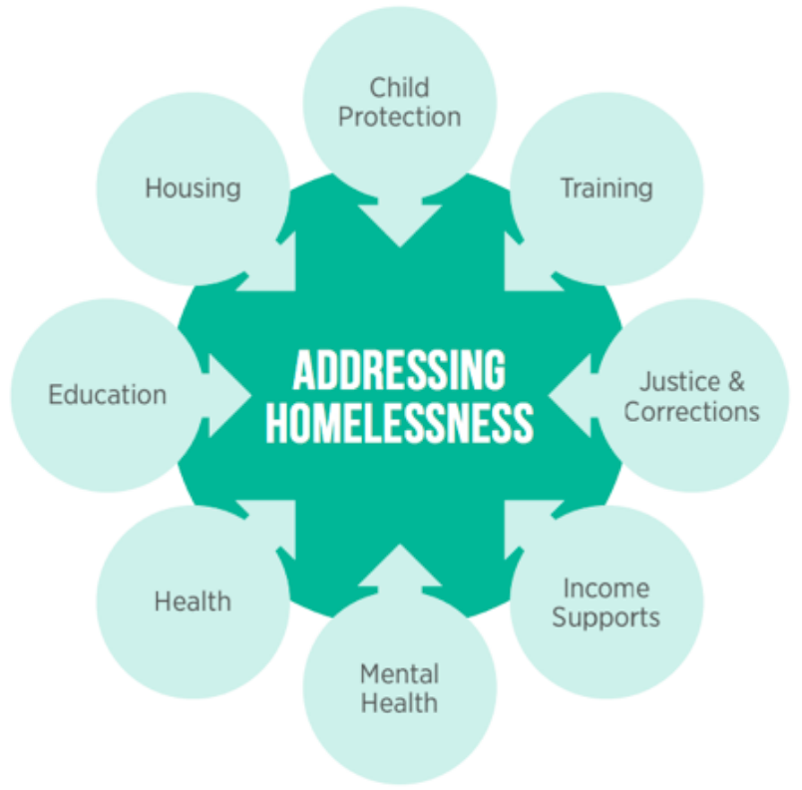
Governments must be:
Prioritizing and supporting systems integration in all efforts to proactively address those at-risk of homelessness or experiencing homelessness.
As part of this systems integration, all provincial/territorial ministries and departments should be mandated to identify their roles and responsibilities in homelessness.

Slide 36
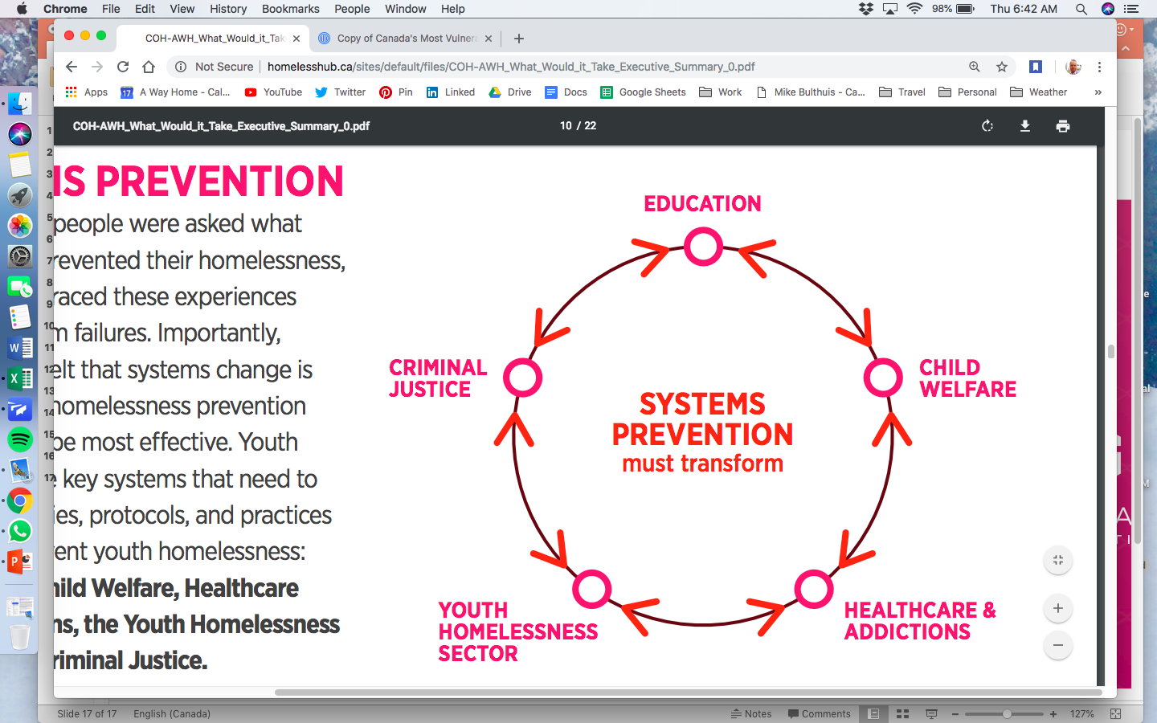
Governments must be:
Engaged in the ongoing review of current system barriers to assess how the prevention of homelessness can be improved across systems, including through integration and improved access to services, supports, and housing.

Slide 37
Questions?

